Slide 1

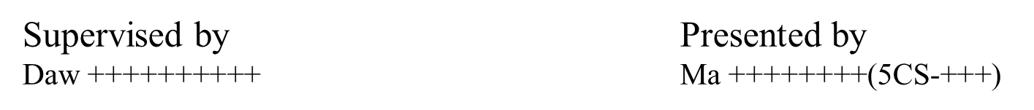
Internship Training and Project Presentation On “Accomplished in Hap Eye Co,. Ltd”
UNIVERSITY OF COMPUTER STUDIES, (MANDALAY )
2.6.2022

Slide 2
Outline Of Presentation
Introduction
Brief History of Nura Dev Company
Training Program
SWOT Analysis
Product Line
Conclusion

Slide 3
1.Introduction
I've already talked about internships in the report, so now I'll talk
about the application I developed during the internship. This application is
not developed by me alone. It was developed separately by my friends
Thwe Zin Minn and Yin Kyae Wai.
I wrote this application to make it convenient for people to visit
Kyaukse if they are visiting Kyaukse and if they need help. Thus we gave
name of this application to Kyaukse Directory. This application was
developed in the Android language.

Slide 4
Nura Dev Company
Nura Dev was born in the year 2015. The company has been kick-started by one great man – Jeopardy with the exceptional passion & long vision.
Nura Dev moved to a proper office with 3 employees and came out as a strongest team of talented geeks and by the end of 2018, company had successfully reached the mark of 25+ employees.
You can contact this organization as
Tel: 09973437020,
Gmail: nuradevelopers@gmail.com

Slide 5
Training Program
Learn many front-end languages.
Gather requirements for our projects from many similar websites.
The supervisor assigns everyone of us to read some topics such as
digital marketing strategies, programming knowledge etc.

Slide 6
Strengths
Leaders are well managed, so I think employees are less stress.
It motivates us to try hard working in IT and how smart after being a professional.
It can also share strategies on how to improve our passions.
Finally, it is warmly welcome to internship students in every year.

Slide 7
Weakness
Less training and presentation for the work that we did and what we will do.
There are few times for us to work together with Senior Software developers.
The rules for employees are weak as it is a family-type management.

Slide 8
Opportunities
They have a lot of technical expertise, which allows students to gain a wealth of experiences in the future IT career.
It can also provide many jobs for computer students.
It can provide comprehensive growth training for young leaders in Myanmar without much experiences.

Slide 9
Threats
There are many weak in the employee management, this will affect the image of Nura Dev Company.
This requires a lot excellent workers in business site. It can be a challenge in future.

Slide 10
Product Line
This is a directory application for Kyaukse city that includes 19
categories such as Pagoda, Places to visit, Hotels, Restaurant, Bank, Petrol,
Health, Help and etc., If you have plan to travel Kyaukse or anything you
want to know about this city please feel free to find detail information by this
application.
It contains 7 pages. The first page includes Pagoda, Places to visit,
Hotels, Restaurant, Bank, Petrol, Health, Help, Shops in Kyaukse. If you
click these and More, See All, go to the next pages. But I explained the pages
that I coded.

Slide 11
Abstract of Project
Blogs are a new and intriguing form of communication and personal expressions. People have become more interested in events of all kinds, and will travel far away to participate in events that they find interesting.
Nowadays, blogs are used in multiple platforms not only business field but also IT fields such as digital marketing.

Slide 12
Aim and Benefit of Blogging
Blogging is an essential part of online marketing strategy for many businesses. Following are just a few benefits of blogging,
Provides an venue to organize your thoughts and ideas.
Allow you to showcase your skills, creativity and talents.
using travel blogs to plan your trip, is that you can be super-specific in searching for content that is relevant to you.
And when it comes to using travel blog sites to plan your trip, well their sole purpose is to promote the area.
Next time you’re planning a trip, get on google and be super-specific about what you’re looking for. You might just be surprised what you turn up.
Many bloggers make money from their blogs using various monetization methods.
Businesses use blogging to bring more potential customers to their websites.
Non-profits can use blogs to raise awareness, run social media campaigns, and influence public opinion.

Slide 13
Tools and Technology
WordPress
Xampp
Elementor
Elementor pro
Plugin

Slide 14
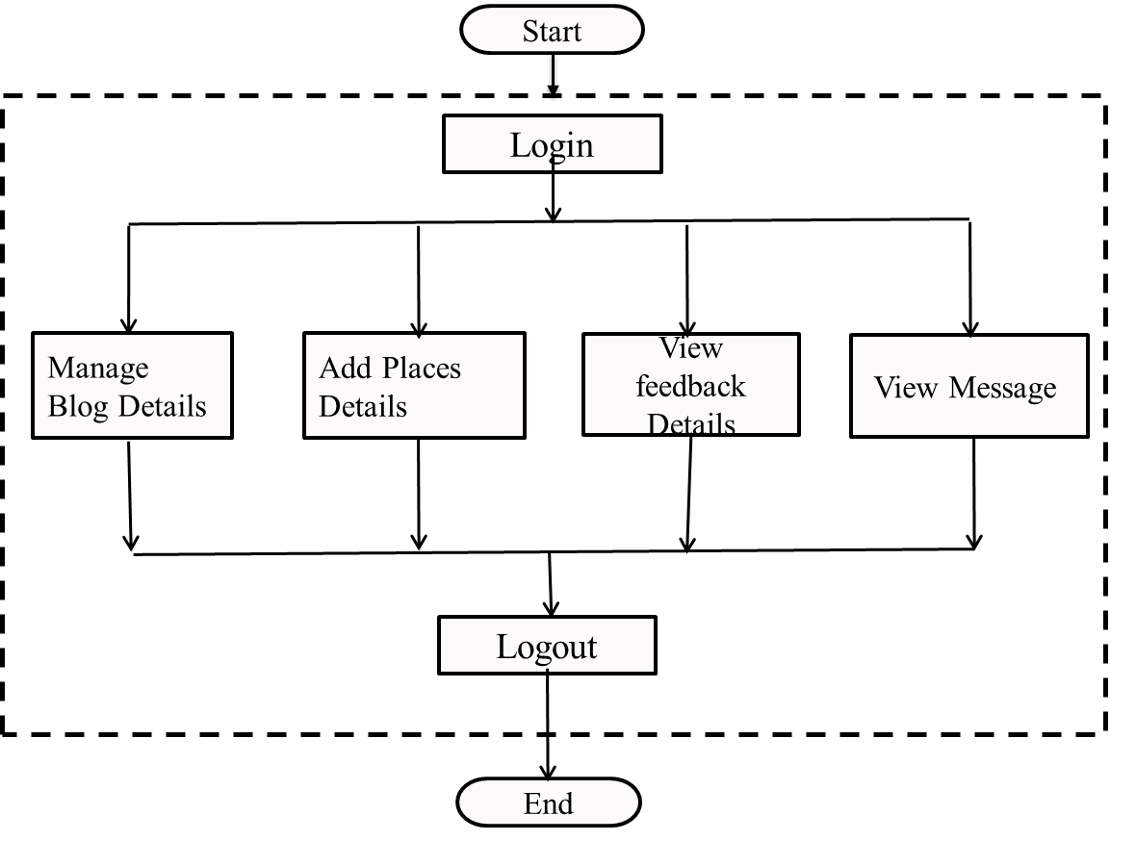
System Flow Chart for Admin

Slide 15
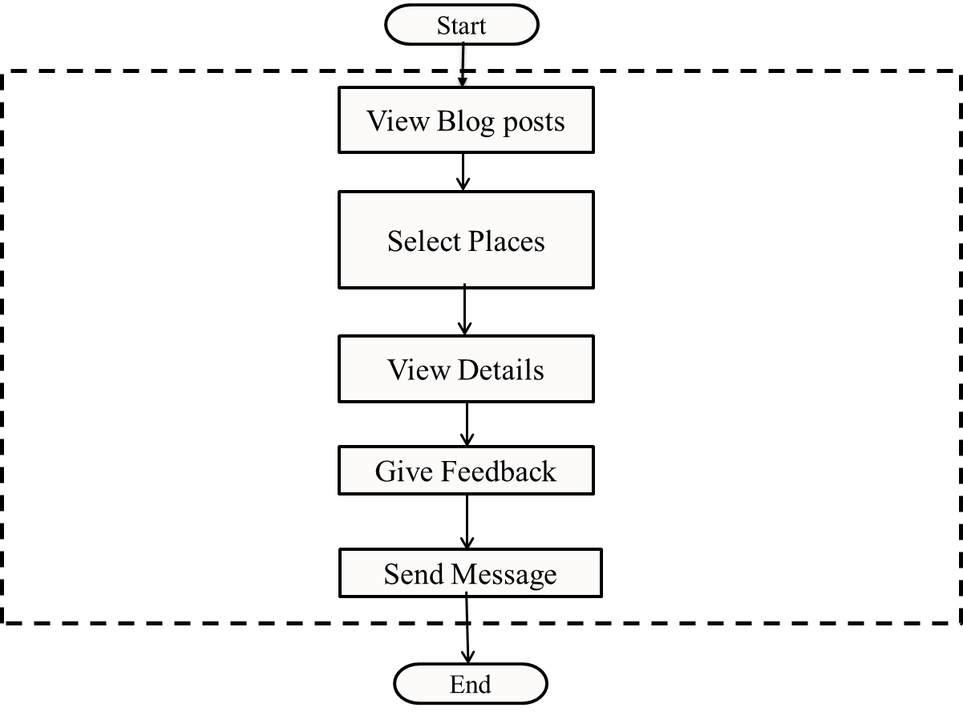
System Flow Chart for User

Slide 16
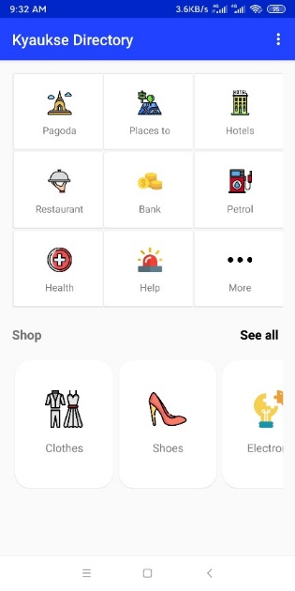
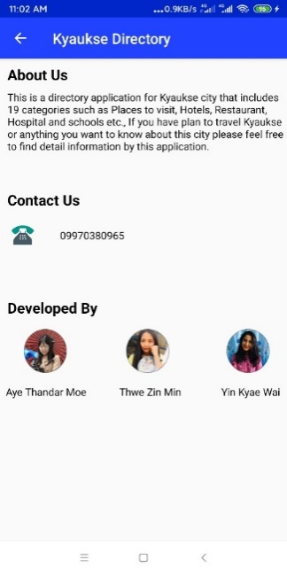
My Pages
I developed the pages for More, Restaurant, Health, Beauty, University and
Training, Transport, Workshop with Android. This is the first and about us of
application. The first page describes the short cut of all categories in this application.
And About Us page describes about the application, the developers of this application
and how to connect them.

Slide 17
Recycler View, Recycler Adapter, Image View, Card View and Text View are used to show the first page.
And the About Us is simple because it uses Text View and Image View without adapter and any other logics .
This pages are the first page for me to develop my first android application.

Slide 18
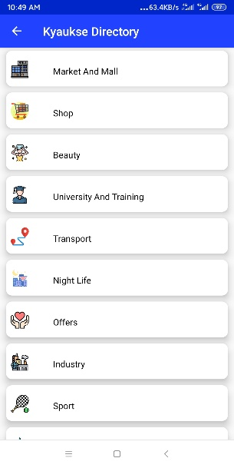
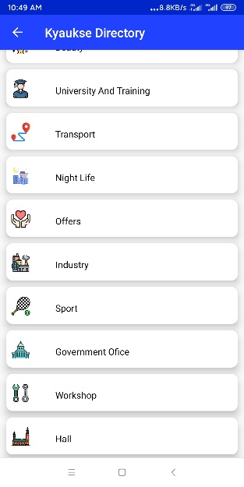
If you clicked More Category in the first page, you will see this pages in
below. The More Page consists of all these categories and to show this page I
develop using Image View, Text View, Card View and Recycler View and
recycler adapter.

Slide 19
I developed the codes for one activity using fragment and fragment adapter.
I retrieve the data from firebase at the moment that adding data values to
that page. And this page includes Card View, Image View, Text View,
Toolbar. This pages is used for the categories that cannot reach direct
information. For example Beauty category that have Cosmetics Stores,
Saloon and Spa. Restaurant, Health, Shop, Beauty, University & Training,
Transport and Workshop are included in this activity because they cannot
reached direct information. I will show only all the field that include in this
categories.

Slide 20
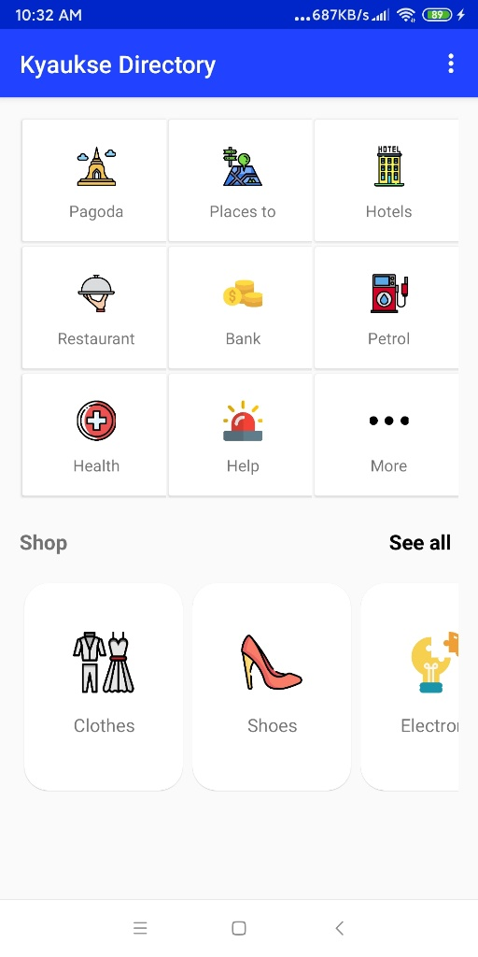
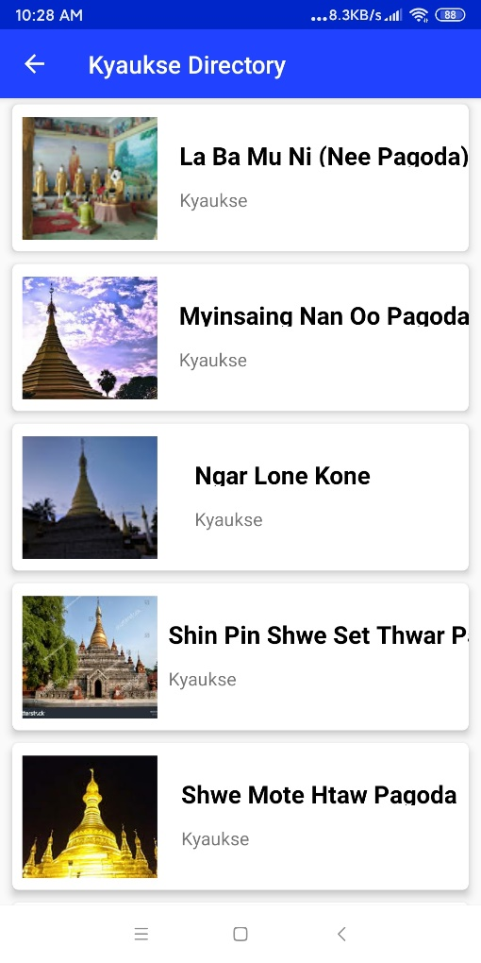
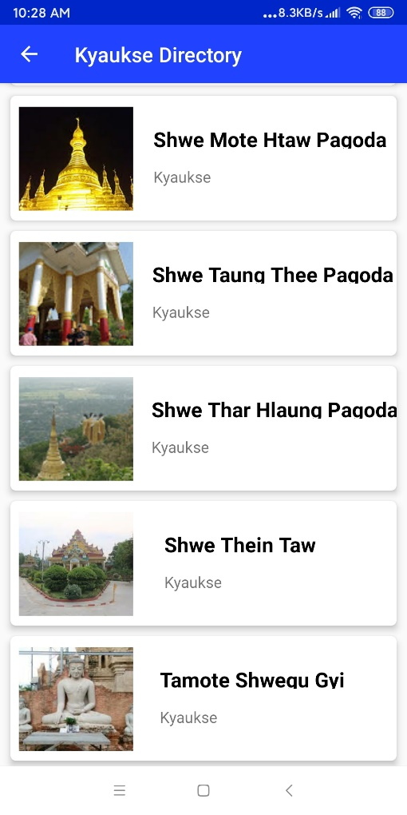
That is the example of the page that reaches to the direct information.

Slide 21
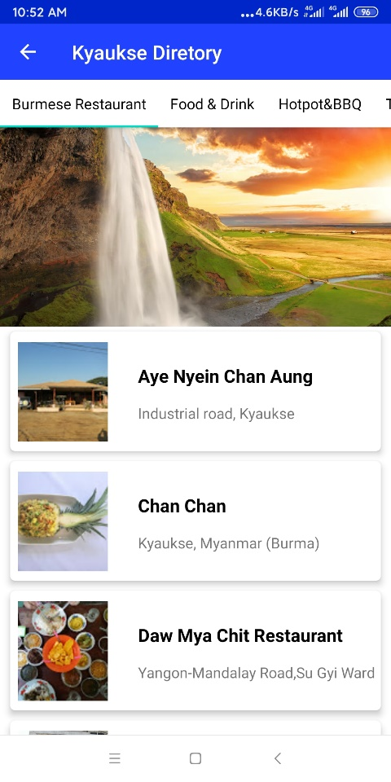
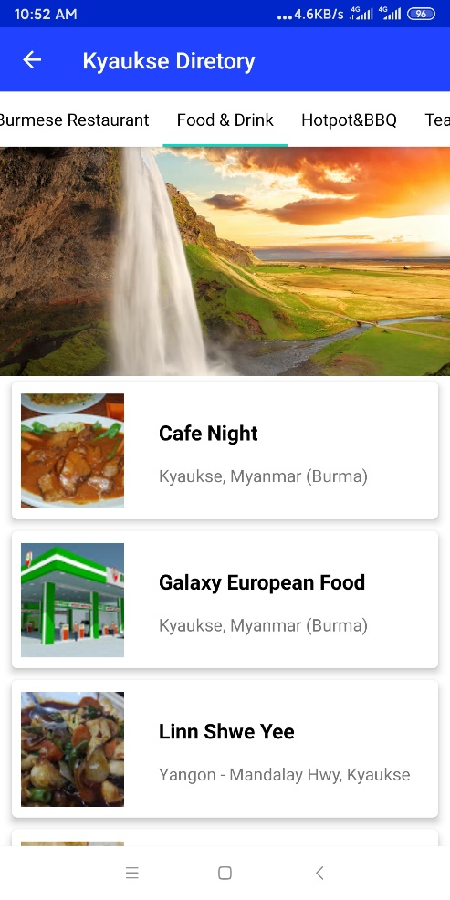
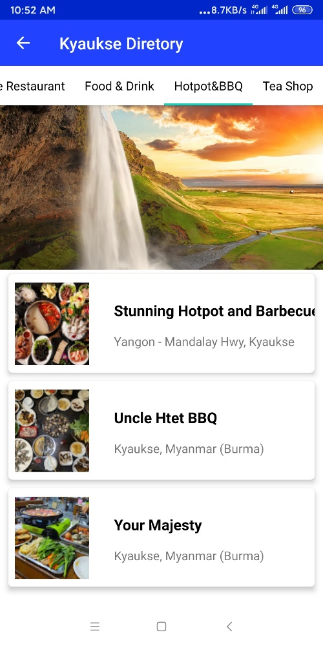
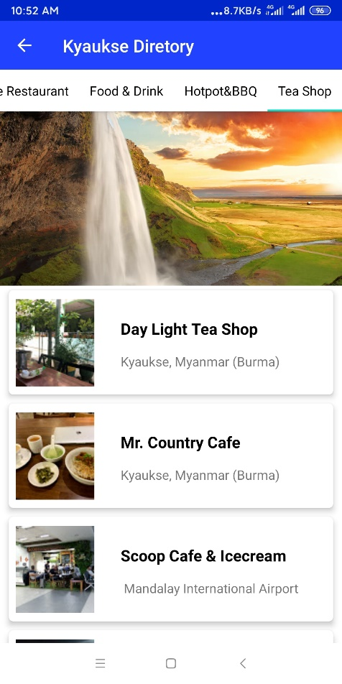
Burmese Restaurant, Food and Drink, Hotpot And BBQ, Tea Shop are included in Restaurant Category.

Slide 22
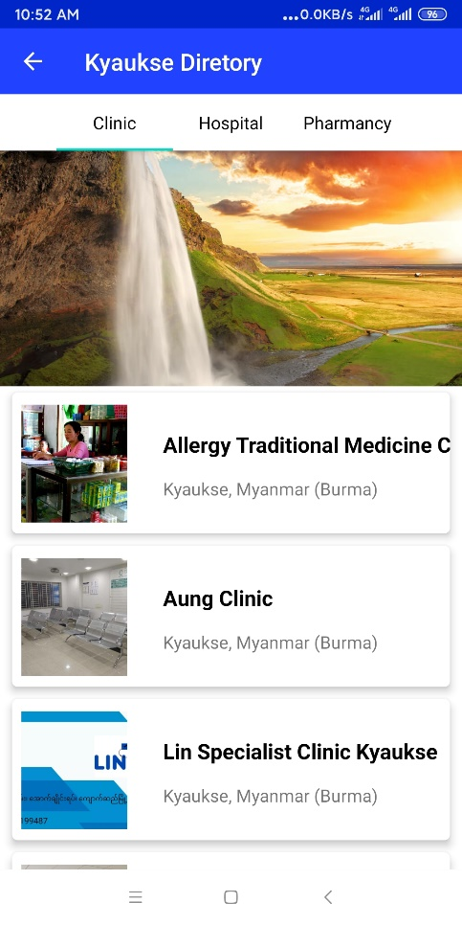
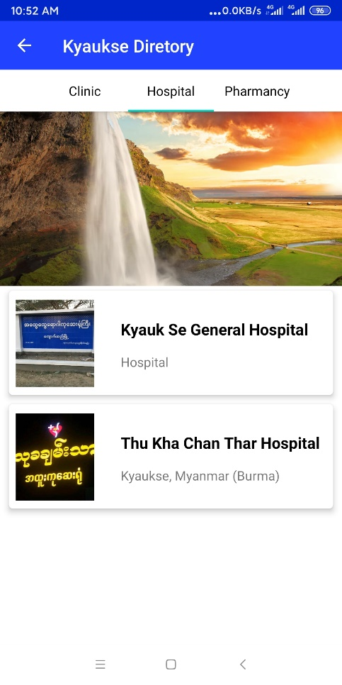
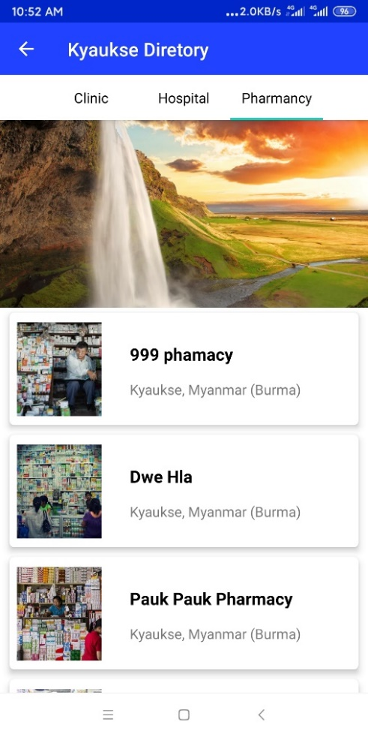
Clinic, Hospital, Pharmacy are included in Health Category.

Slide 23
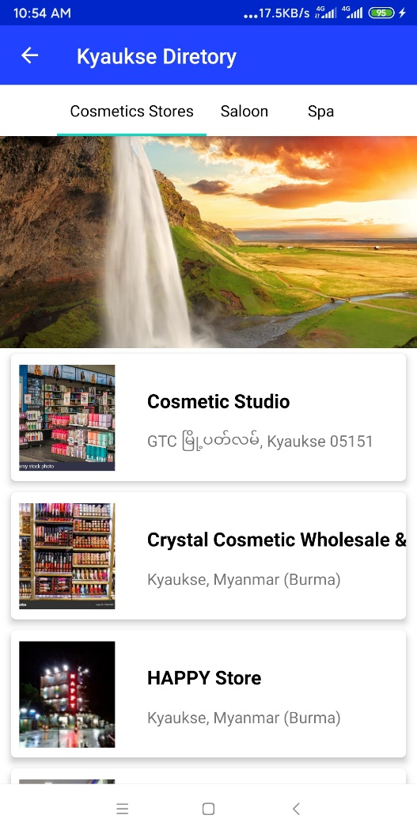
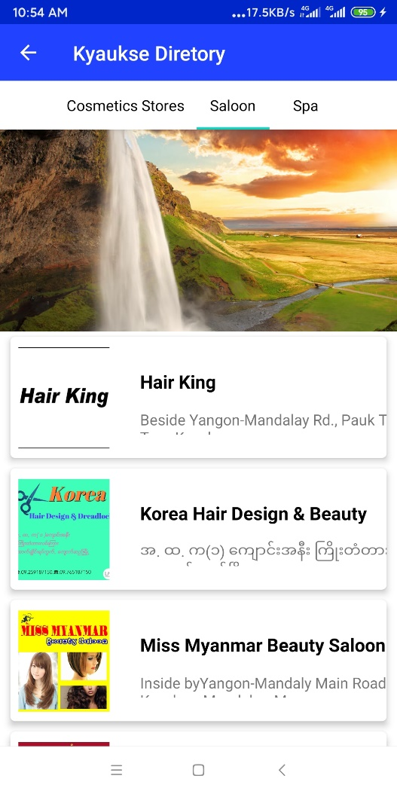
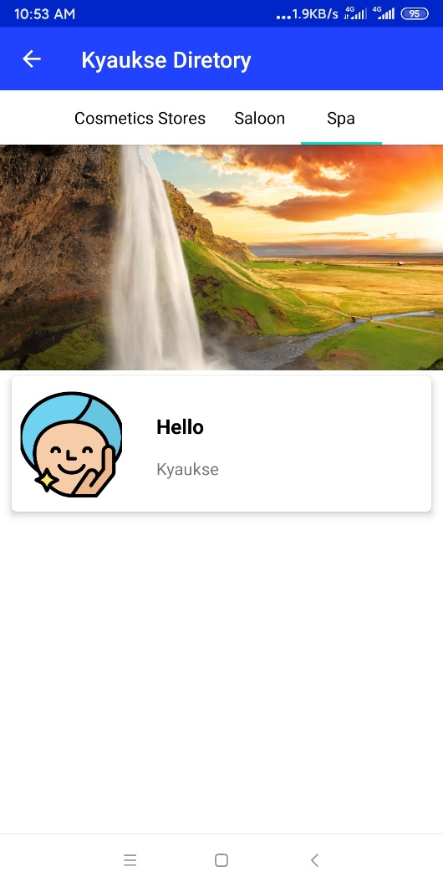
Cosmetics Stores, Saloon, and Spa are included in Beauty Category.

Slide 24
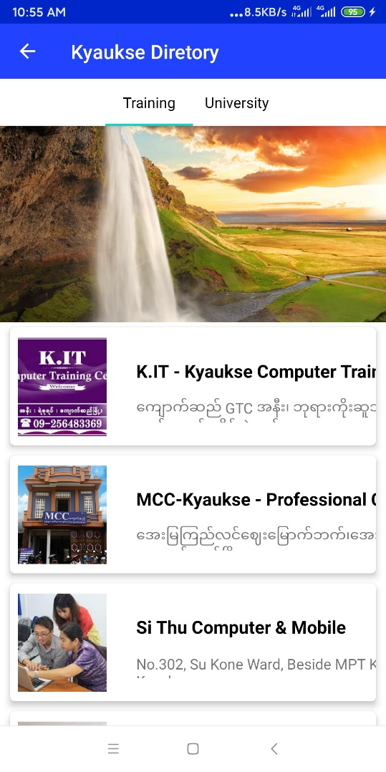
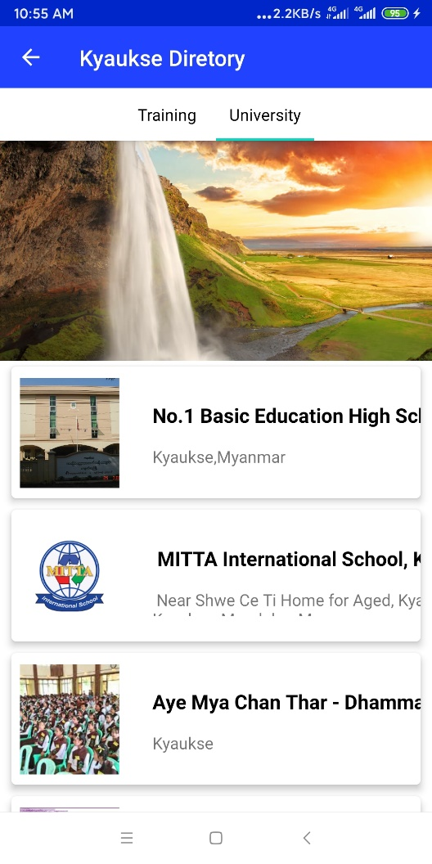
University and Training are included in University & Training category.

Slide 25
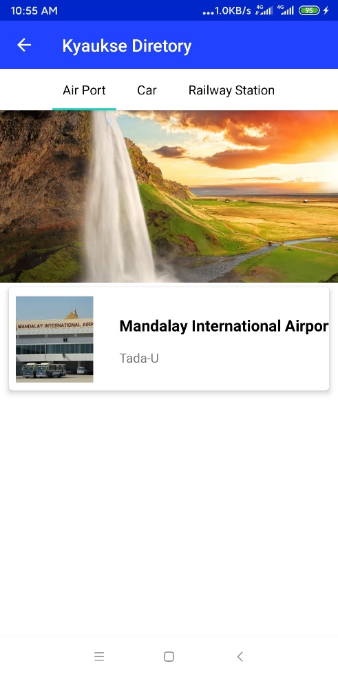
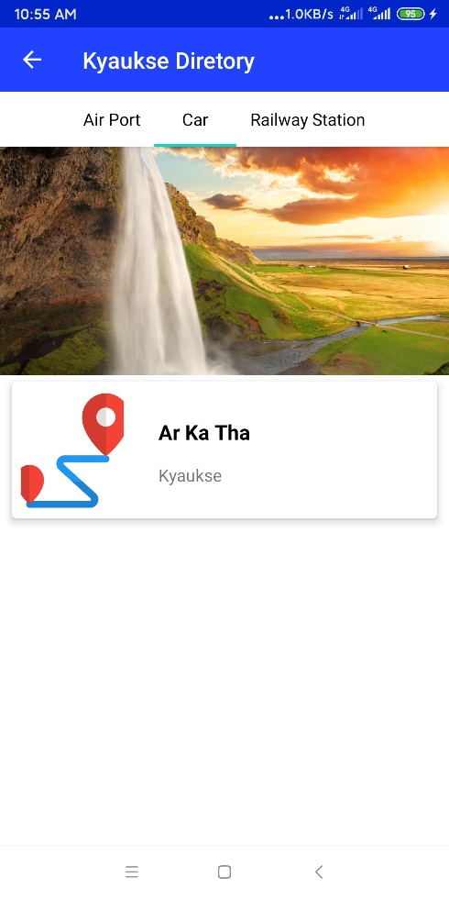
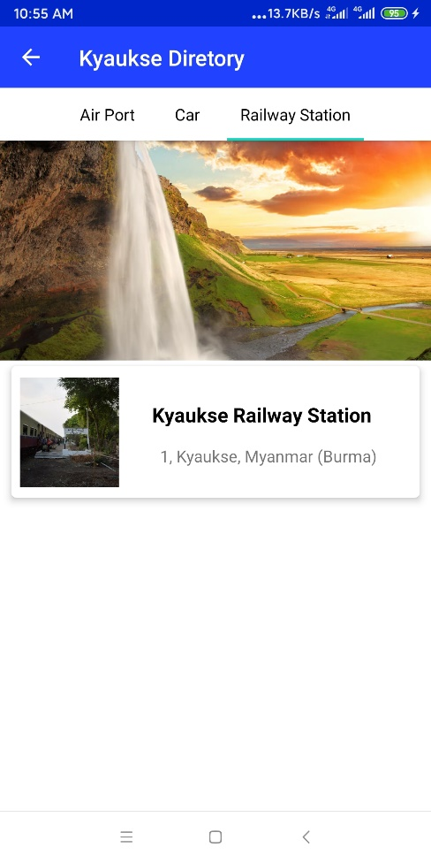
Air Port, Car, Railway Station are included in Trasport category.

Slide 26
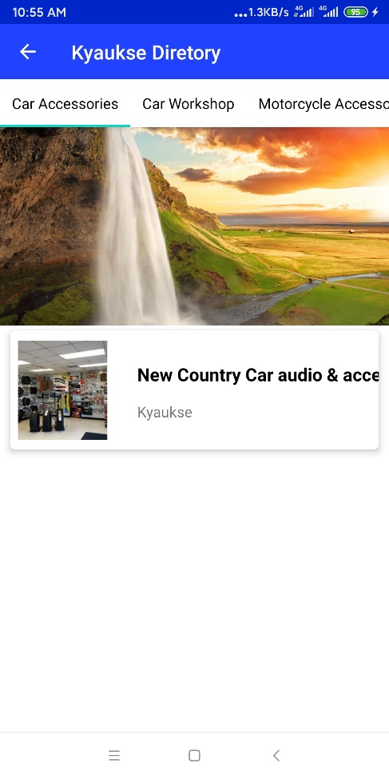
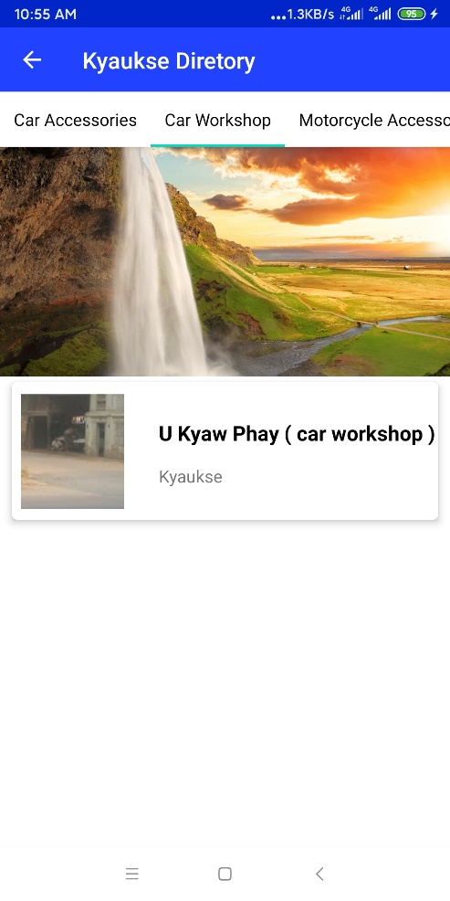
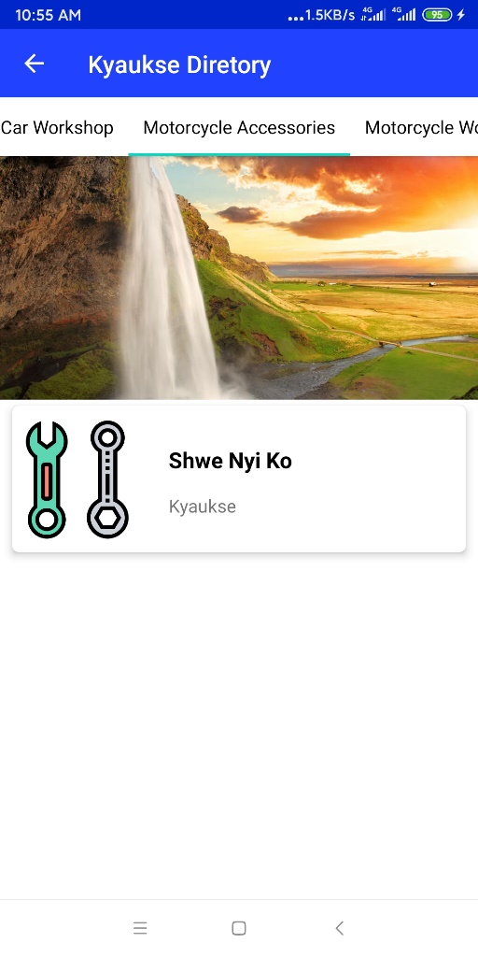
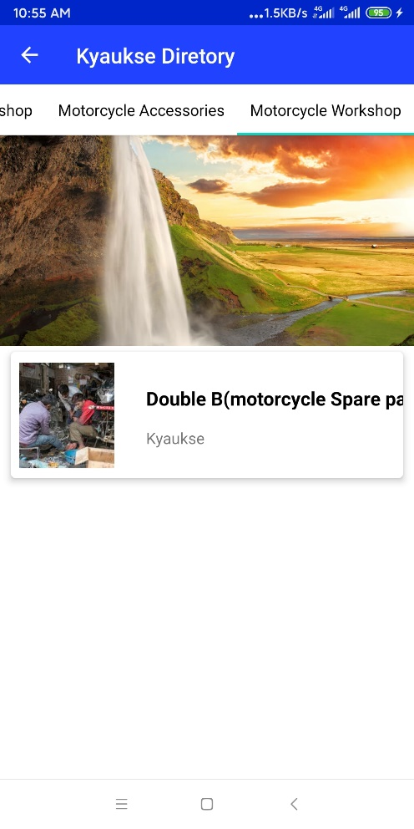
Car Accessories, Car Workshop, Motorcycle Accessories, Motorcycle Workshop are included in Workshop category.

Slide 27
Conclusion
Learned new knowledge, programming skills, code learning and latest technology from this internship program..
Internship opportunities can help us determine strengths, abilities, weakness, etc.
Nura Dev Company is a good place for internship because it is very useful for real interns.

